Slide 1
Programming Study Cryptography
Sungwoo Nam
2018.3.9

Slide 2
Poco::Crypto
PocoCrypto.dll
Depends on OpenSSL :
libssl-1_1.dll, libcrypto-1_1.dll

Slide 3
Symmetric Encryption
Alice
"Tall tree, Spy-glass shoulder, ... Skeleton Island ESE and by E"
#include "Poco/Crypto/Cipher.h"
#include "Poco/Crypto/CipherKey.h"
#include "Poco/Crypto/CipherFactory.h"
auto& factory = CipherFactory::defaultFactory();
string transmission;
{
Cipher* alice =
factory.createCipher( CipherKey(
"aes-256-ecb",
"open sesame"));
transmission = alice->encryptString(
"Tall tree, Spy-glass shoulder, ...
Skeleton Island ESE and by E");
}
{
Cipher* bob =
factory.createCipher( CipherKey(
"aes-256-ecb",
"open sesame"));
string decrypted =
bob->decryptString(transmission);
assert(decrypted ==
"Tall tree, Spy-glass shoulder, ...
Skeleton Island ESE and by E");
}
encrpytion
“open sesame”
"Dx[,ž4|g6‡j\x1cî\xeûH™Ýd@TÌ¼a3[\x6úh%4™É.\x1ÚEŽ\x10IÀ¨`Ï¹žˆ\x1dÝ9\x14a\x2ú\x6Ñ}-C\b†u9"
Bob
decrpytion
“open sesame”
"Tall tree, Spy-glass shoulder, ... Skeleton Island ESE and by E"

Slide 4
OpenSSL public and private key
>openssl.exe genrsa -des3 -out private_bob.pem 2048
Generating RSA private key, 2048 bit long modulus
...................+++
.................................................................+++
unable to write 'random state'
e is 65537 (0x10001)
Enter pass phrase for private_bob.pem:
Verifying - Enter pass phrase for private_bob.pem:
>openssl.exe rsa -in private_bob.pem -outform PEM -pubout -out public_bob.pem
Enter pass phrase for private_bob.pem:
writing RSA key

Slide 5
Asymmetric Encryption
Alice
"Tall tree, Spy-glass shoulder, ... Skeleton Island ESE and by E"
#include "Poco/Crypto/RSAKey.h"
#include "Poco/Crypto/RSADigestEngine.h“
auto& factory = CipherFactory::defaultFactory();
string transmission;
{
Cipher* alice = factory.createCipher(RSAKey(
"public_bob.pem"));
transmission = alice->encryptString(
"Tall tree, Spy-glass shoulder, ...
Skeleton Island ESE and by E");
}
{
Cipher* bob = factory.createCipher(RSAKey(
"", "private_bob.pem", "bobbob"));
string decrypted =
bob->decryptString(transmission);
assert(decrypted == "Tall tree, Spy-glass shoulder, ... Skeleton Island ESE and by E");
}
encrpytion
Bob’s public key
"39\x12\rd6Ç\x1e)øH%Ø£ÃÏ\x1fß¤A\bÎ½]?©\tø[ôíäÍkA\"~7øíEÆ\f´\x1c\x1†Ìbo’&\x10‡t>E¡”\xfÂ‚ú\x5ç`Mñ\...
Bob
decrpytion
private key
"Tall tree, Spy-glass shoulder, ... Skeleton Island ESE and by E"

Slide 6
Digital Signature
Bob
Bob’s private key
sign
"39\x12\rd6Ç\x1e)øH%Ø£ÃÏ\x1fß¤A\bÎ½]?©\tø[ôíäÍkA\"~7øíEÆ\f´\x1c\x1†Ìbo’&\x10‡t>E¡”\xfÂ‚ú\x5ç`Mñ\...
"Alice will give Bob $100 and Bob will give Alice two magic mushrooms"
Alice
verify
Bob’s public key
True or False

Slide 7
Digital Signature in coding
// Poco::DigestEngine::Digest is std::vector<unsigned char>
tuple<string, Poco::DigestEngine::Digest > transmission;
{
string contract =
"Alice will give Bob $100 and Bob will give Alice two magic mushrooms";
RSADigestEngine bob(RSAKey("", "private_bob.pem", "bobbob"));
bob.update(contract);
transmission = make_tuple(contract, bob.signature());
}
{
RSADigestEngine alice(RSAKey("public_bob.pem"));
alice.update(get<0>(transmission));
bool isValid = alice.verify(get<1>(transmission));
assert(isValid == true);
}

Slide 8
Digital Signature – cheating
// Poco::DigestEngine::Digest is std::vector<unsigned char>
tuple<string, Poco::DigestEngine::Digest > transmission;
{
string contract =
"Alice will give Bob $100 and Bob will give Alice two magic mushrooms";
RSADigestEngine bob(RSAKey("", "private_bob.pem", "bobbob"));
bob.update(contract);
transmission = make_tuple(contract, bob.signature());
}
{
RSADigestEngine alice(RSAKey("public_bob.pem"));
alice.update(
"Alice will give Bob $100 and Bob will give Alice three magic mushrooms");
bool isValid = alice.verify(get<1>(transmission));
assert(isValid == false);
}

Slide 9
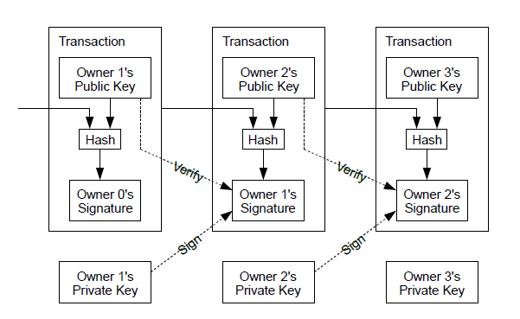
Chained Transaction
Ref : Bitcoin : A Peer-to-Peer Electronic Cash System, Satoshi Nakamoto

Slide 10
Transaction – Queen to Alice
struct Transaction
{
string Hash;
vector<unsigned char> Signature;
};
Transaction queenToAlice;
{
// Queen
RSAKey alicePublic("public_alice.pem");
stringstream alicePublickey;
alicePublic.save(&alicePublickey);
Crypto::DigestEngine hasher("SHA256");
hasher.update("Queen's own right to create coin");
hasher.update(alicePublickey.str());
string hash = Crypto::DigestEngine::digestToHex(
hasher.digest());
RSADigestEngine queen(RSAKey("", "private_queen.pem", "queenqueen"));
queen.update(hash);
queenToAlice = Transaction{ hash, queen.signature() };
}
Queen -> Alice
Alice public key
Hash
Queen’s signature

Slide 11
Transaction – Alice verification
Queen -> Alice
Alice public key
{
// Alice
RSADigestEngine alice(RSAKey("public_queen.pem"));
alice.update( queenToAlice.Hash );
assert( true == alice.verify(queenToAlice.Signature));
}
Hash
Queen’s signature

Slide 12
Transaction –Alice to Bob
Transaction aliceToBob;
{
// Alice
RSAKey bobPublic("public_bob.pem");
stringstream bobPublickey;
bobPublic.save(&bobPublickey);
Crypto::DigestEngine hasher("SHA256");
hasher.update(queenToAlice.Hash);
hasher.update(queenToAlice.Signature.data(),
queenToAlice.Signature.size());
hasher.update(bobPublickey.str());
string hash = Crypto::DigestEngine::digestToHex(
hasher.digest());
RSADigestEngine alice(RSAKey("",
"private_alice.pem", "alicealice"));
alice.update(hash);
aliceToBob = Transaction{ hash, alice.signature() };
}
Alice -> Bob
Bob public key
Hash
Alice’s signature

Slide 13
Transaction – Bob verification
Queen -> Alice
Bob public key
{
// Bob
RSADigestEngine bob(RSAKey("public_alice.pem"));
bob.update(aliceToBob.Hash);
assert(true == bob.verify(aliceToBob.Signature));
}
Hash
Alice’s signature

Slide 14
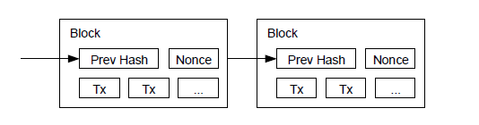
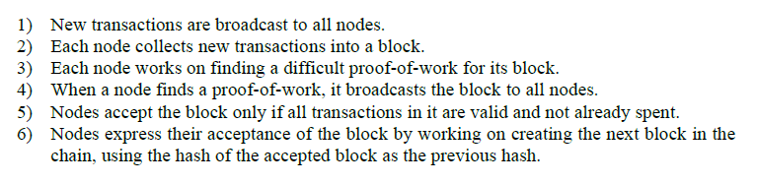
Block Chain

Slide 15
Proof of work
struct Transaction { string Hash, Signature; };
struct Block {
string PrevHash, Nounce;
vector<Transaction> Transactions;
};
Block t0 = {
"Hello, world!", "4250", { Transaction{ "", "" } }
};
// verfiy t0 block's transactions and proof-of-work
hasher.update(t0.PrevHash);
for (auto tx : t0.Transactions) {
hasher.update(tx.Hash); hasher.update(tx.Signature);
}
hasher.update(t0.Nounce);
t1.PrevHash = Crypto::DigestEngine::digestToHex(hasher.digest());
assert(t1.PrevHash.substr(0, 4) == "0000");

Slide 16
Proof of work
// gather transactions
t1.Transactions = {
Transaction{ "ab", "cd" },
Transaction{ "12", "34" },
Transaction{ "56", "78" } };
// race for the nounce
for (int nounce = 0;; ++nounce)
{
hasher.reset();
hasher.update(t1.PrevHash);
for (auto tx : t1.Transactions) {
hasher.update(tx.Hash); hasher.update(tx.Signature);
}
hasher.update(to_string(nounce));
string hash = Crypto::DigestEngine::digestToHex(hasher.digest());
if (hash.substr(0, 4) == "0000") {
t1.Nounce = to_string(nounce);
break;
}
}
// broadcast t1 block to world

Slide 17
Honest chain vs Attacker chain
$$$
$$$

